Slide 1
Point Estimates
and Sampling Variability

Slide 2
Point estimation
We are often interested in population parameters.
Since complete populations are difficult (or impossible) to collect data on, we use sample statistics as point estimates for the unknown population parameters of interest.

Slide 3
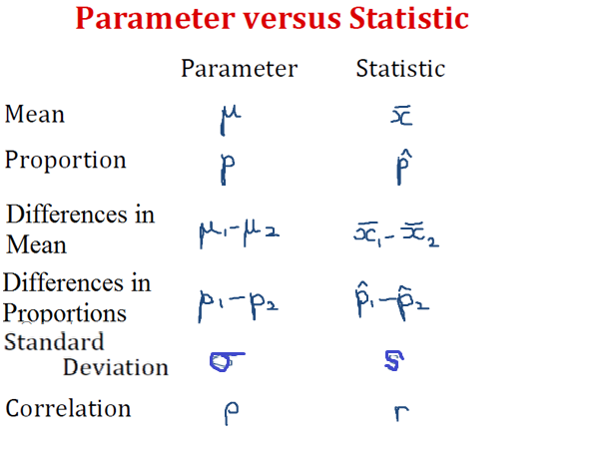
Point estimation

Slide 4
Sample statistics vary from sample to sample.
Suppose we are interested in the mean height of John Carroll students. We randomly sample 100 John Carroll students. Would you expect the sample means of their heights to be the same, somewhat different, or very different?
Suppose we are interested in percent of smokers at John Carroll. We randomly sample 100 John Carroll students. Would you expect the sample percentage of smokers to be the same, somewhat different, or very different?

Slide 5
Sampling Distribution
A sampling distribution is the distribution of sample statistics computed for different samples of the same size from the same population.
https://www.lock5stat.com/StatKey/index.html

Slide 6
Sampling distributions are never observed
In real-world applications, we never actually observe the sampling distribution, yet it is useful to always think of a point estimate as coming from such a hypothetical distribution.
Understanding the sampling distribution will help us characterize and make sense of the point estimates that we do observe.

Slide 7
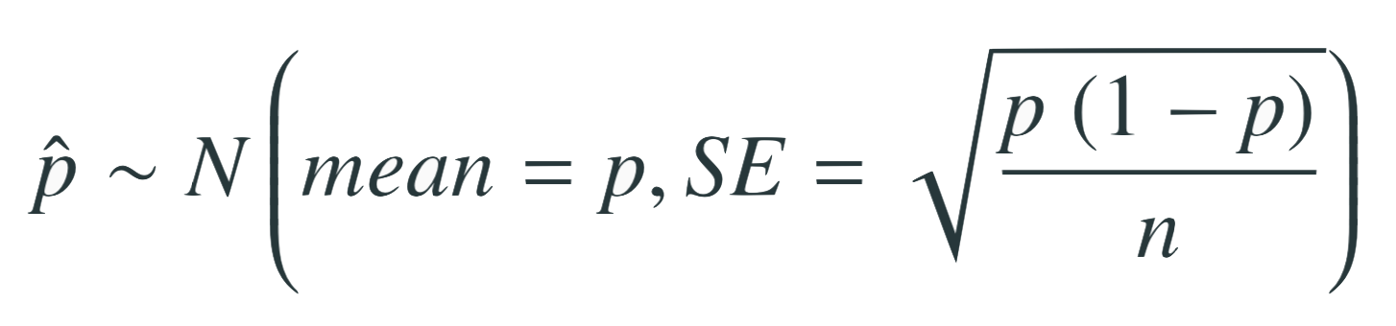
Standard Error
The standard error, SE, is the standard deviation of the sample statistic.
We use SE to measure the uncertainty of the point estimate.
For a sampling distribution of sample proportions,
For a sampling distribution of sample means,
We won’t go through a detailed proof, but note that as n increases SE decreases.

Slide 8
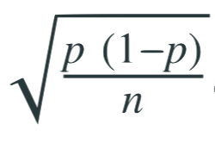
Central Limit Theorem
Sample proportions will be nearly normally distributed with mean equal to the population proportion, p, and standard error equal to

Slide 9
CLT - conditions
Certain conditions must be met for the CLT to apply:
Independence
Sampled observations must be independent.
Sample size
There should be at least 10 successes and 10 failures in the observed sample.

Slide 10
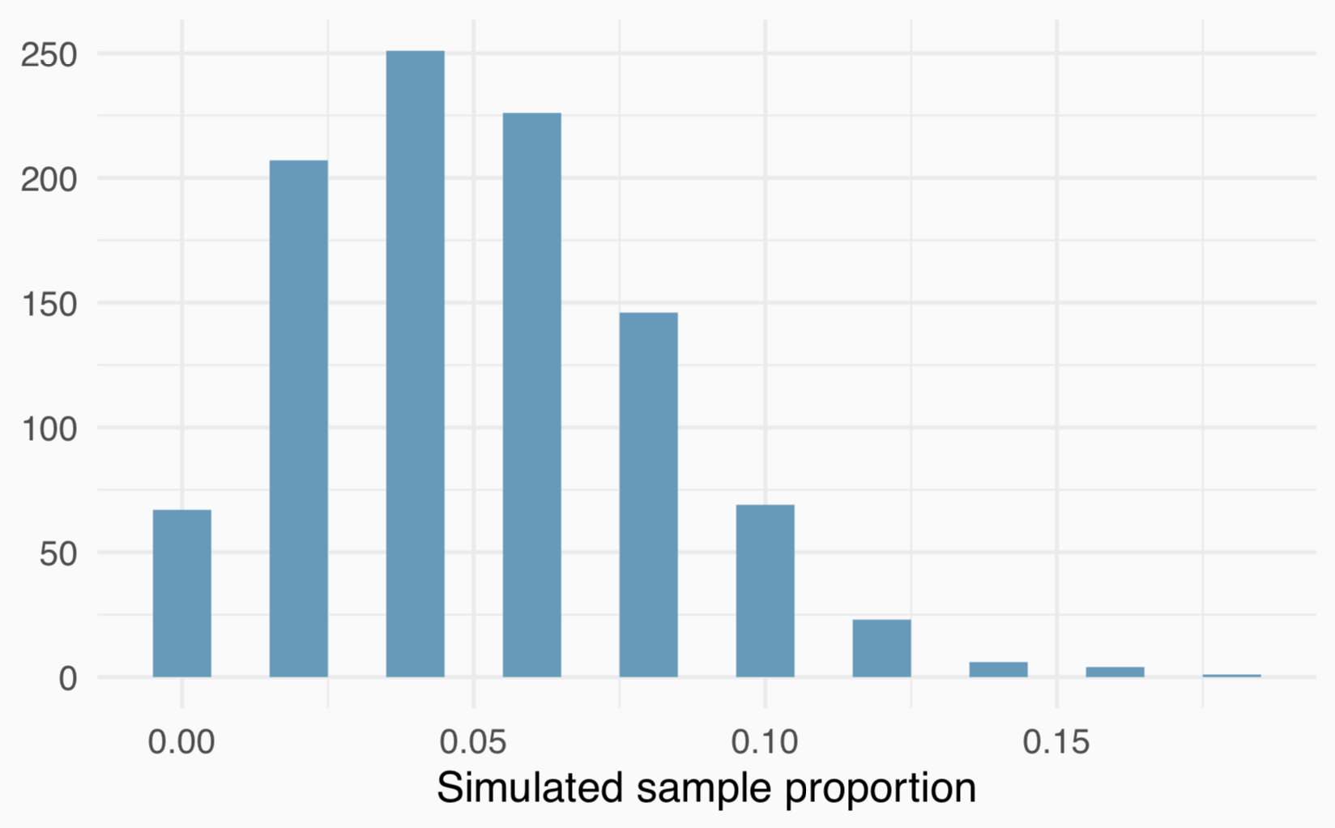
When np or n(1 - p) is small
Suppose we have a population where the true population proportion is p = 0.05, and we take random samples of size n = 50 from this population. Would you expect this distribution to be nearly normal?
No, the success-failure condition is not met (50 x 0.05 = 2.5), so we would not expect the sampling distribution to be nearly normal.

Slide 11
Extending the framework for other statistics
The strategy of using a sample statistic to estimate a parameter is quite common, and it’s a strategy that we can apply to other statistics
Take a random sample of students at a college and ask them how many extracurricular activities they are involved in to estimate the average number of extra curricular activities all students in this college are interested in.
The principles and general ideas are from this chapter apply to other parameters as well, even if the details change a little.

Slide 12
Sampling distribution of sample means
What is the shape and center of this distribution? Based on this distribution, what do you think is the true population average?

Slide 13
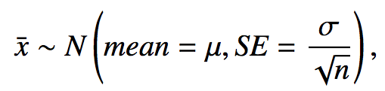
Central Limit Theorem
The distribution of the sample mean is well approximated by a normal model:

Slide 14
CLT - conditions
Certain conditions must be met for the CLT to apply:
Independence: Sampled observations must be independent.
Sample size / skew: Either the population distribution is normal, or the sample size is large.
The more skewed the population distribution, the larger sample size we need for the CLT to apply.
n > 30 is a widely used rule of thumb.

